Slide 1

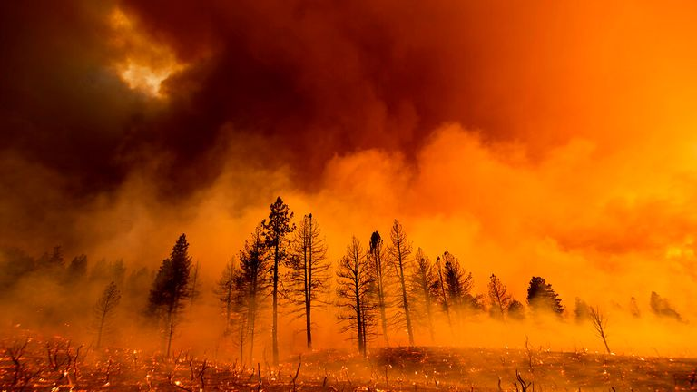
DETECTION OF FIRE COMBUSTION IN FOREST USING IBM WATSON STUDIO
DONE BY:
MOHIT HARPALANI
MANIPAL ACADEMY OF HIGHER EDUCATION DUBAI CAMPUS

Slide 2
Index
Introduction
Purpose
Training The Model
Testing The Model
Application
Future Scope
Conclusion

Slide 3
Introduction
Forest fires occur all year, with greater severity in the summer and fall seasons, and generally cause catastrophic harm to both nature and humans. Forest fires are mostly caused by human activity, such as lightning strikes, spontaneous combustion of dry leaves or saw dust, and are regarded as a major contributor to air pollution. Various techniques have been used to combat forest fires throughout the years, with the primary goal of early identification of flames.
The continuous review of information and communication technology has resulted in the emergence of a new generation of solutions for early detection and prevention of forest fires, such as machine learning deployment using IBM Watson studio , Application of Convolution Neural Network.

Slide 4
Purpose
The recent forest fire tragedy has gotten a lot of attention across the world. Significant causes of forest fires are either human or environmental in nature.
The continuous evaluation of information and communication technology has resulted in the introduction of a new generation of solutions for the early detection and prevention of forest fires, such as the deployment of a machine learning model using IBM Watson studio and the application of a convolution neural network.
Implementing the aforementioned solutions will aid in the early identification of forest fires throughout the world, stopping them from spreading further.

Slide 5
Training the Model
For training the model I used tensorflow, keras libraries.
I also used activation function like relu, sigmoid .
I have trained my model for 10 times (epochs).

Slide 6
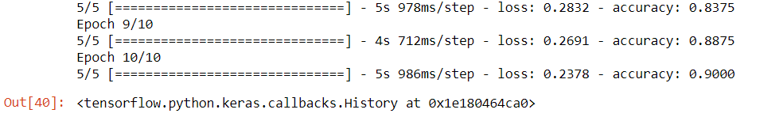
Testing the Model
I ran my model through its paces on my system, and the results are as follows:
The testing showed 100% accuracy

Slide 7
Application
The major use of this model is to forecast whether or not the supplied image contains a forest fire. It has been thoroughly trained to anticipate the right data.

Slide 8

Future Scope
Artificial Intelligence and Machine Learning may be used to detect forest fires by focusing on daytime photos and identifying smoke and flames quickly, decreasing false positives and the time it takes for fire crews to arrive on the site.

Slide 9
Conclusion
For this project, I utilized Jupiter notebook, Anaconda prompt, and IBM Watson Studio to train and deploy my model. IBM is committed to advancing technology and efforts to improve forest fire response.
The train accuracy is 91.5 percent without a pre-trained Keras model, while the validation accuracy is 91.5 percent.
90 percent
The validation result has an accuracy of 93.48 percent at its best.
It has been discovered thatDespite the fact that the training accuracy is greater than 90% when no pre-trained Keras model is used, the overallIn contrast to when a pre-trained model is employed, accuracy is poor.

Slide 10
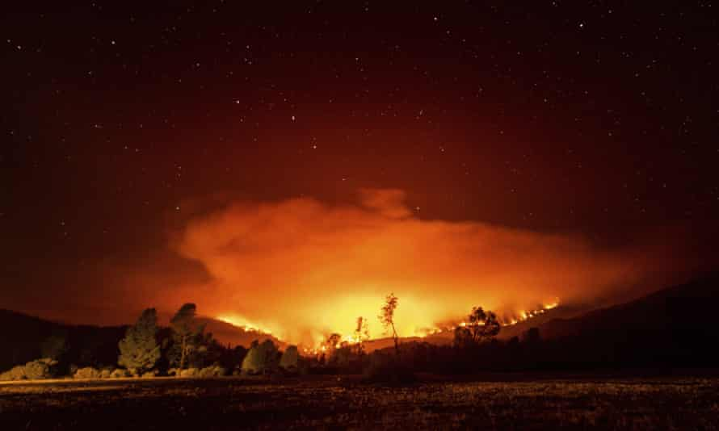
THANK YOU

